Slide 1
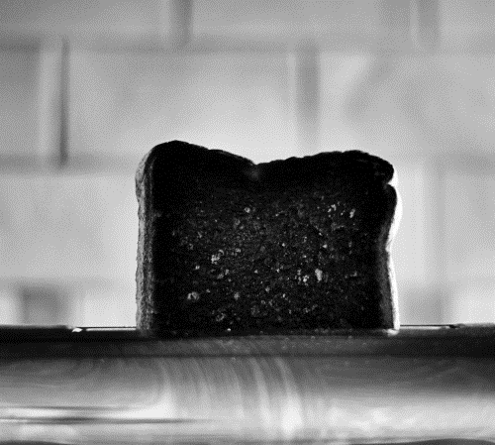

BurntToast:
A Little on the Dark Side
Josh King

Slide 2
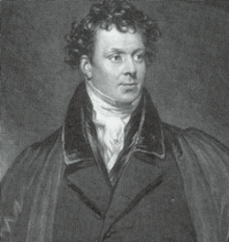
Who Am I?
Josh King
@WindosNZ

https://king.geek.nz
✶

Slide 3
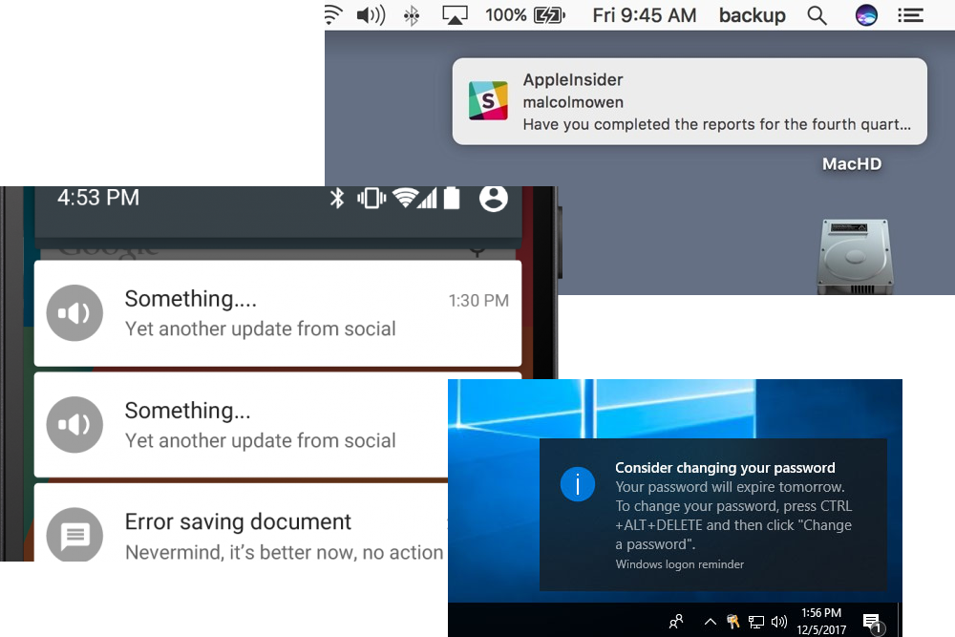
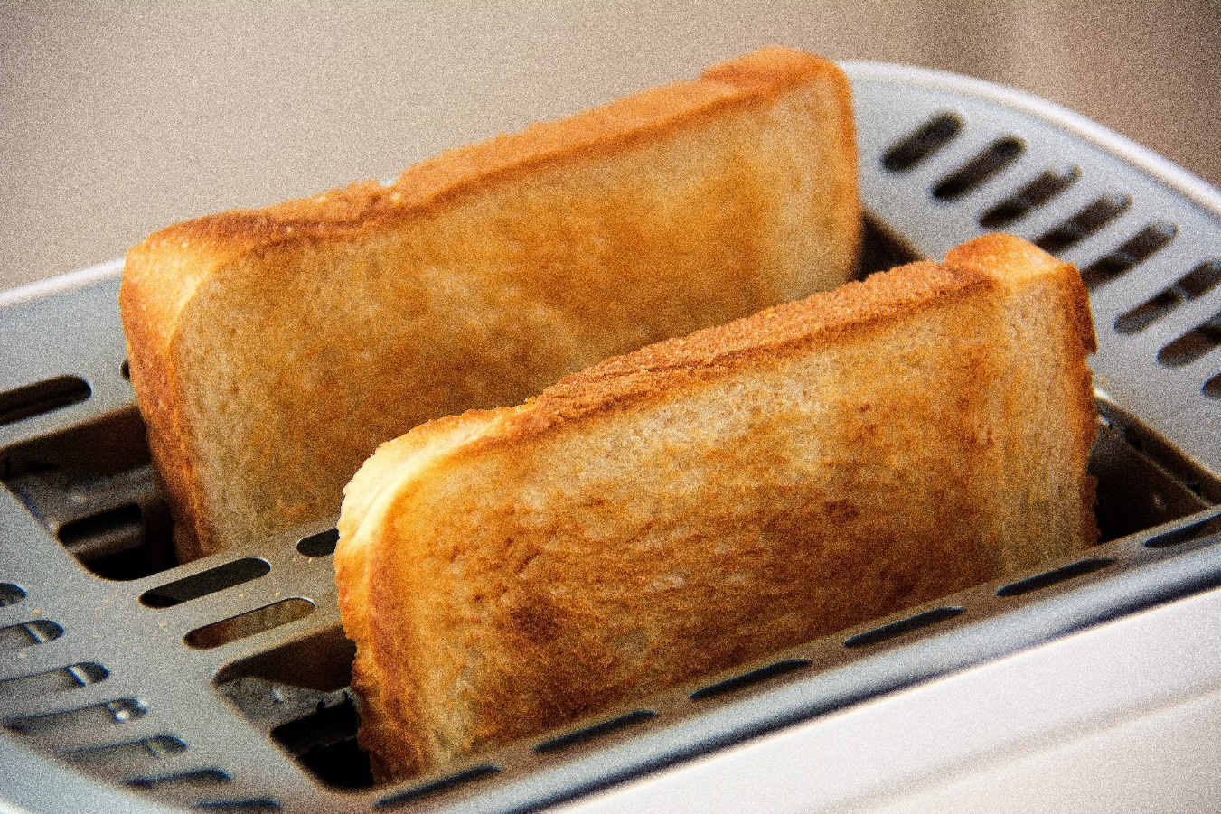
What Is Toast?

Slide 4
New-BurntToastNotification `
-Text 'BurntToast:', 'A Little on the Dark Side'

Slide 5
New-BurntToastNotification `
-Text 'BurntToast:', 'A Little on the Dark Side'

Slide 6
New-BurntToastNotification `
-Text 'WAKE UP!' `
-Sound 'Alarm2'

Slide 7
New-BurntToastNotification `
-Text 'WAKE UP!' `
-Sound 'Alarm2'

Slide 8
$Button = New-BTButton `
-Content 'Open Report' `
-Arguments '\\srv\reports\report.pdf'
New-BurntToastNotification `
-Text 'Report Generated', 'It took 6 hours!' `
-Button $Button

Slide 9
$Button = New-BTButton `
-Content 'Open Report' `
-Arguments '\\srv\reports\report.pdf'
New-BurntToastNotification `
-Text 'Report Generated', 'It took 6 hours!' `
-Button $Button

Slide 10
$Progress = New-BTProgressBar `
-Status 'Generating Report' `
-Value 0.2
New-BurntToastNotification `
-Text 'Massive Report Incoming!' `
-ProgressBar $Progress `
-UniqueIdentifier 'Report1'

Slide 11
$Progress = New-BTProgressBar `
-Status 'Generating Report' `
-Value 0.2
New-BurntToastNotification `
-Text 'Massive Report Incoming!' `
-ProgressBar $Progress `
-UniqueIdentifier 'Report1'

Slide 12
$Progress = New-BTProgressBar `
-Status 'Generating Report' `
-Value 0.6
New-BurntToastNotification `
-Text 'Massive Report Incoming!' `
-ProgressBar $Progress `
-UniqueIdentifier 'Report1'

Slide 13
$Progress = New-BTProgressBar `
-Status 'Completed' `
-Value 1.0
New-BurntToastNotification `
-Text 'Massive Report Generated!' `
-ProgressBar $Progress `
-UniqueIdentifier 'Report1'

Slide 14
THANK YOU!
Get this slide deck from:
http://bit.ly/BurntToastLightning

